Slide 1
Machine Prog: Advanced
Processor Arch: ISA&Logic
TA: 王非石 葛佳鑫

Slide 2
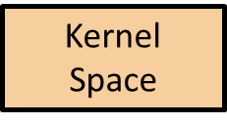
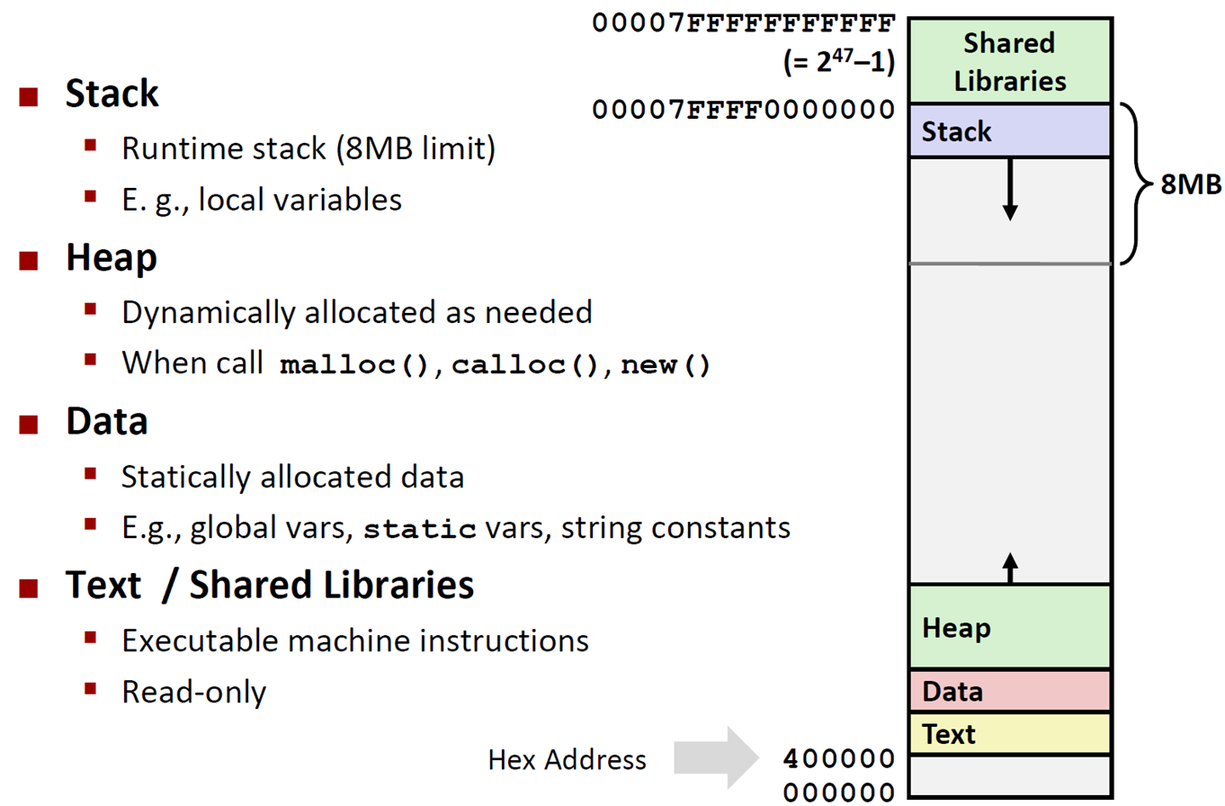
Memory Layout

Slide 3
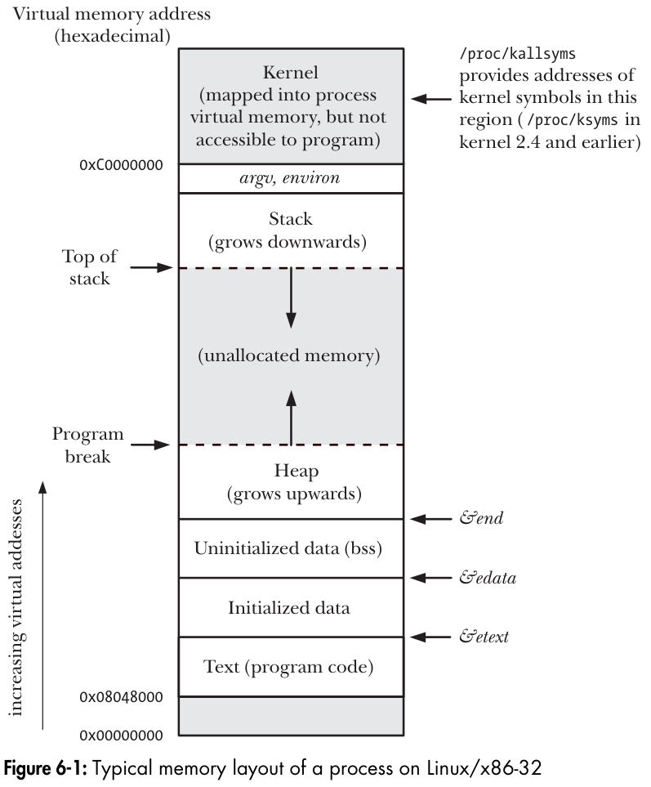
Notes:
注：这个是32位linux的，前一页是64位linux的，地址略有不同

Slide 4
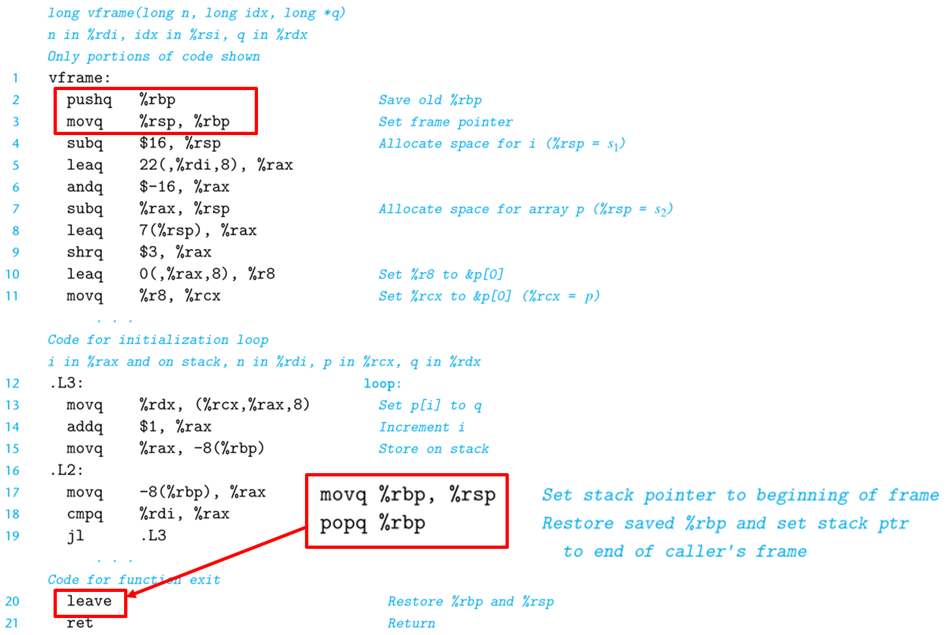
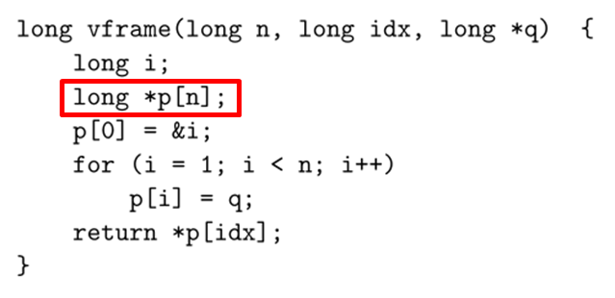
可变长栈帧
%rbp作为帧指针的作用：
• 在整个函数的执行过程中，%rbp始终指向函数栈的顶端（在返回地址和保存被调用者保存寄存器的值的下方）
• 利用固定长度的局部变量相对于%rbp的偏移量来引用它们
• leave指令释放整个栈帧

Slide 5
如何防御堆栈溢出攻击
用fgets规定输入字符串的大小。gets很不安全！
给内存增加可执行权限标记，禁止执行栈上的代码
栈偏移量随机化，无法事先确定数据地址
堆栈金丝雀：%fs:0x28

Slide 6
Additional Exercise : Complicated Declaration
 | sizeof(A) | What is A?
int *A[3];
int *(A[3]);
int (*A)[3];
int (*A[3]);
int (*A[3])();
int (*A[3])[5];
int (*(A[3])())[5];
Hint:
Operator | Read as | Priority
type X(parameters) | function returning type | 0
type X[N] | array[N] of type | 1
*X | pointer to | 2
Notes:
注：这一页不考，但是前四个还是有必要知道的，后面的有兴趣可以了解
最后一个例子取自K&R

Slide 7
Additional Exercise : Complicated Declaration
 | sizeof(A) | What is A?
int *A[3]; | 24 | array[3] of pointer to int
int *(A[3]); | 24 | array[3] of pointer to int
int (*A)[3]; | 8 | pointer to array[3] of int
int (*A[3]); | 24 | array[3] of pointer to int
int (*A[3])(); | 24 | array[3] of pointer to function returning int
int (*A[3])[5]; | 24 | array[3] of pointer to array[5] of int
int (*(A[3])())[5]; | 24 | array[3] of function returning pointer to array[5] of int
Hint:
Operator | Read as | Priority
type X(parameters) | function returning type | 0
type X[N] | array[N] of type | 1
*X | pointer to | 2
Notes:
注：这一页不考，但是前四个还是有必要知道的，后面的有兴趣可以了解
最后一个例子取自K&R

Slide 8
ISA
instruction set architecture
a programmer’s manual
does not contain hardware implementations details
Application
Program
Compiler
OS
ISA
CPU
Design
Circuit
Design
Chip
Layout

Slide 9
RISC&CISC
CISC | RISC
Multiple formats for specifying operands. | Simple addressing formats.
Arithmetic and logical operations can be applied to both memory and register operands. | Arithmetic and logical operations only use register operands. Memory referencing is only allowed by load instructions.
Implementation artifacts hidden from machine-level programs. | Implementation artifacts exposed to machine-level programs.
Condition codes. | No condition codes.
Stack-intensive procedure linkage. | Register-intensive procedure linkage.
CISC | RISC
Easy for compiler. | Need support of advanced compiler.
Fewer code bytes. | More code bytes.
More friendly to assembly code programmer. | Less friendly to assembly code programmer.
Currently dominates markets of PC processors and server processors | Currently dominates markets of embedded processors

Slide 10
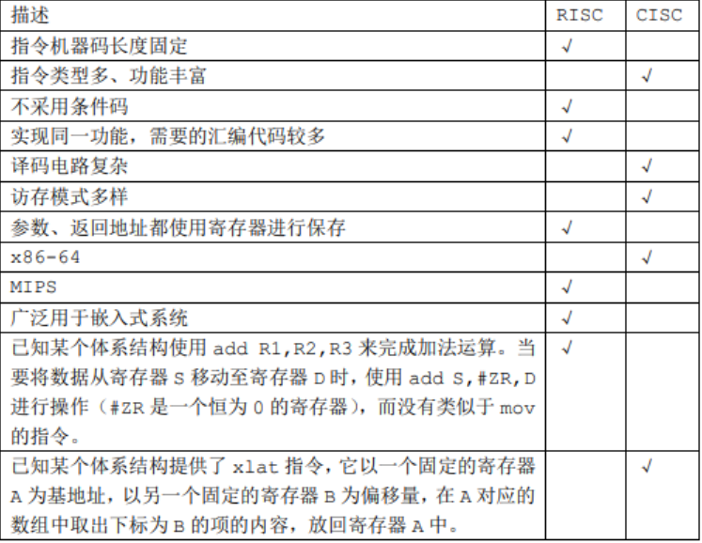
RISC&CISC

Slide 11
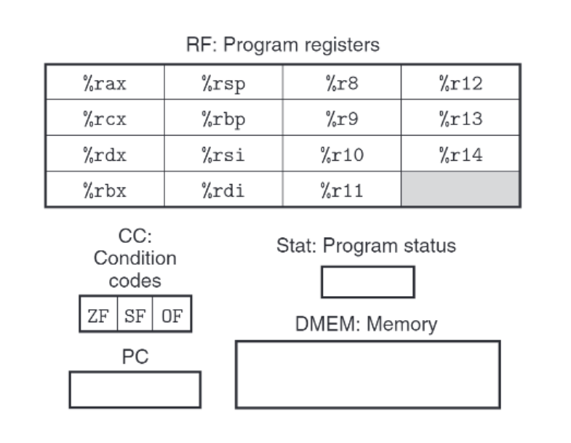
Y86-64
Programmer-visible state
15 registers (16 in x86-64)
1 program counter (RIP)
3 condition codes (4)
1 Stat: program status
(CC&Stat in EFLAGS)

Slide 12
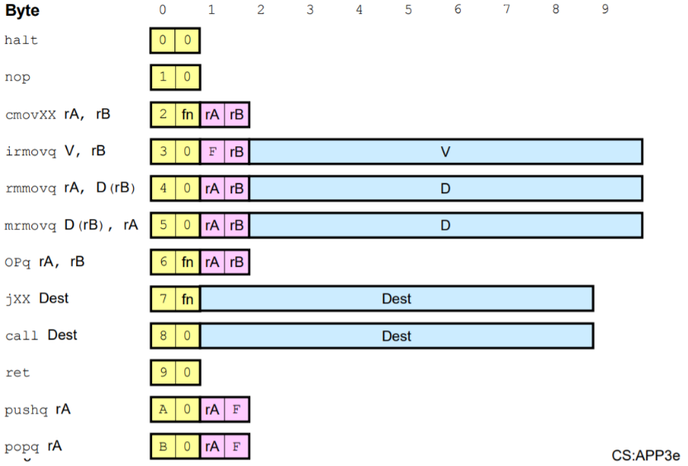
Y86-64
Instruction Code
Function Code
Immediate

Slide 13
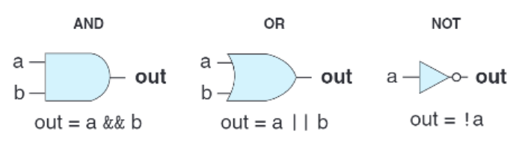
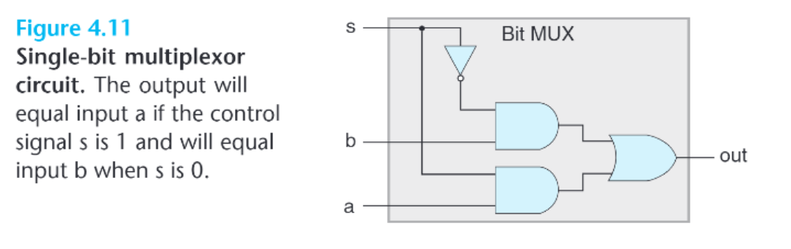
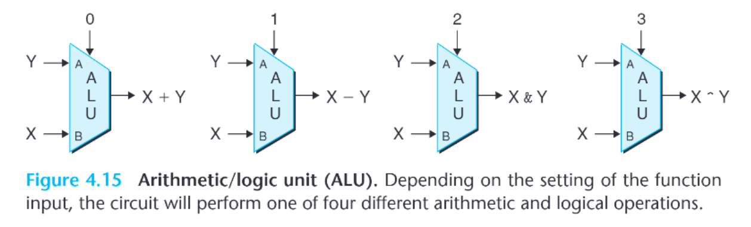
HCL
逻辑门
多路复用器
ALU
Notes:
组合电路

Slide 14
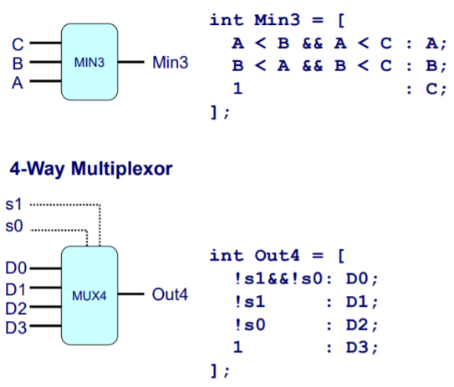
a, b, s: Bit-Level Representation
A, B: Word-Level Representation
Hardware Control Language (HCL)
HCL Examples:
bool eq = (a&&b)||(!a&&!b)
bool Eq = (A == B)
bool res = A in {item1, item2}
Bit-Level Multiplexor:
bool out = (s&&a)||(!s&&b)
Word Multiplexor:
int Out = [
s : A;
1 : B;
];
HCL Word-Level Examples:

Slide 15
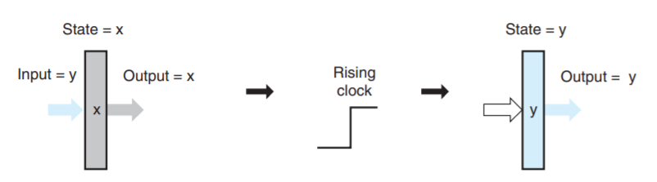
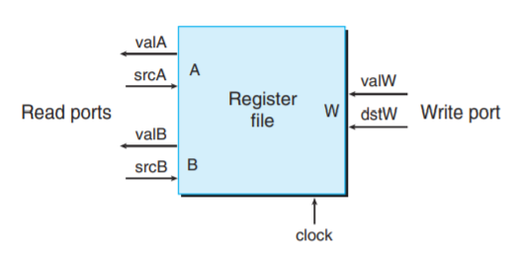
Registers & Register Files
register
register
file

Slide 16
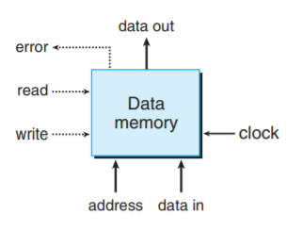
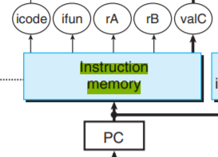
Memories
data memory
instruction
memory

